Slide 1
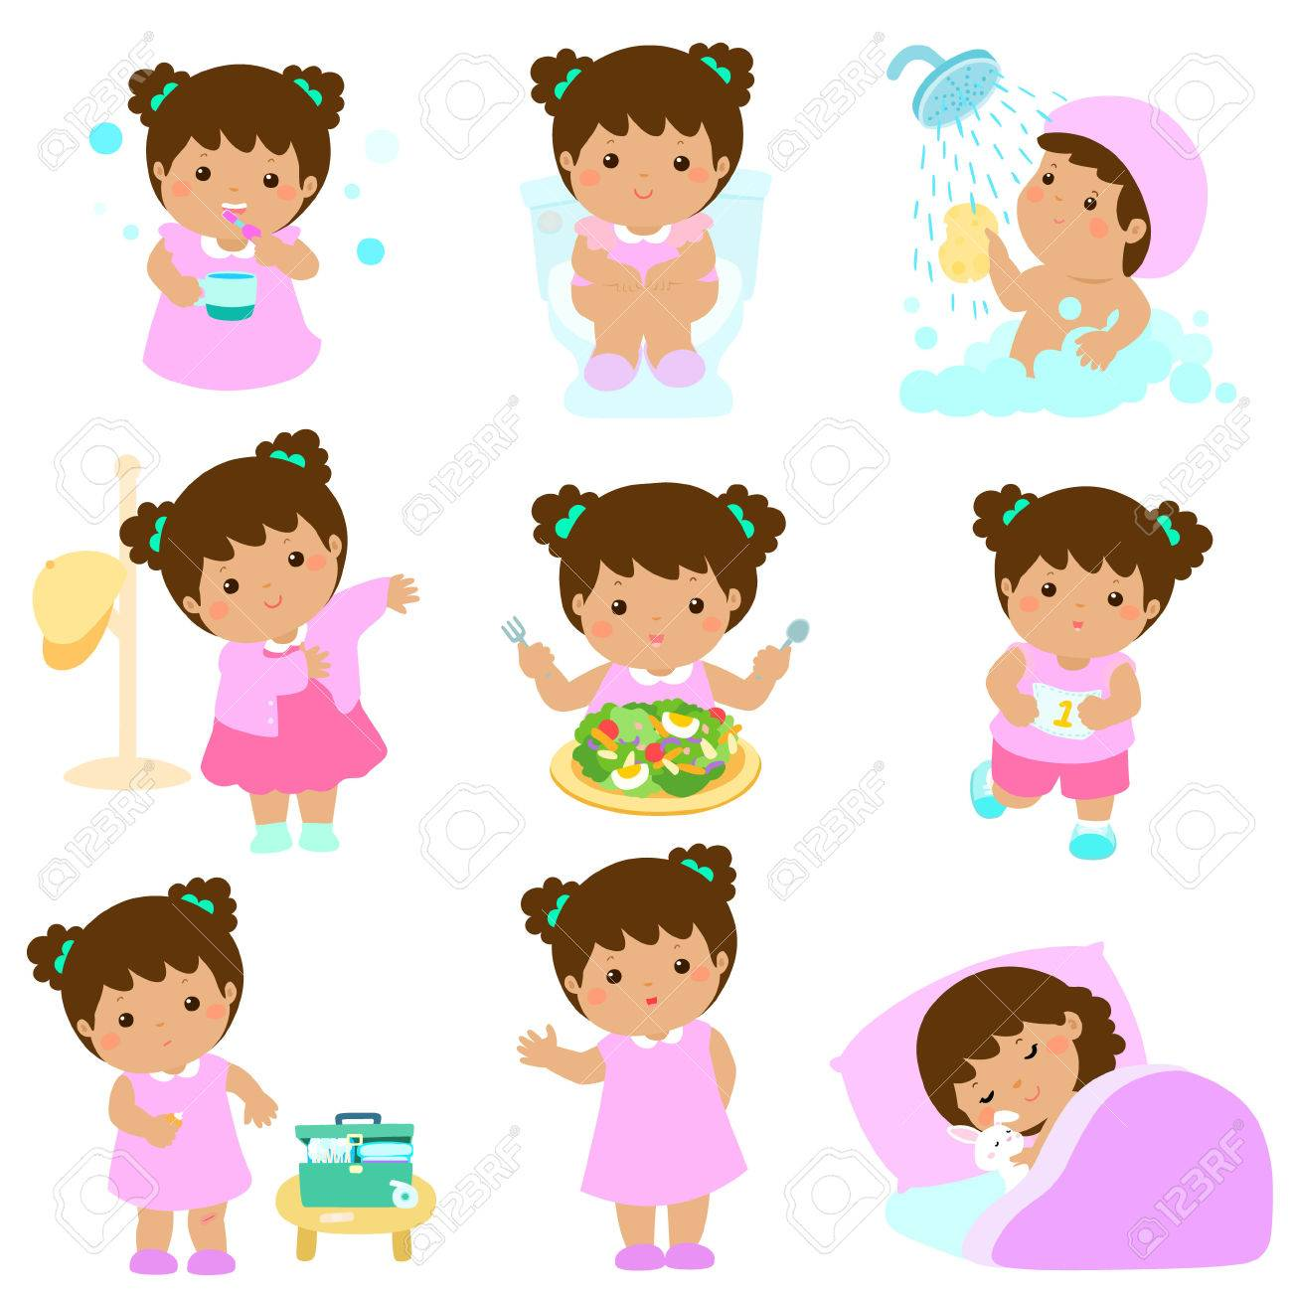
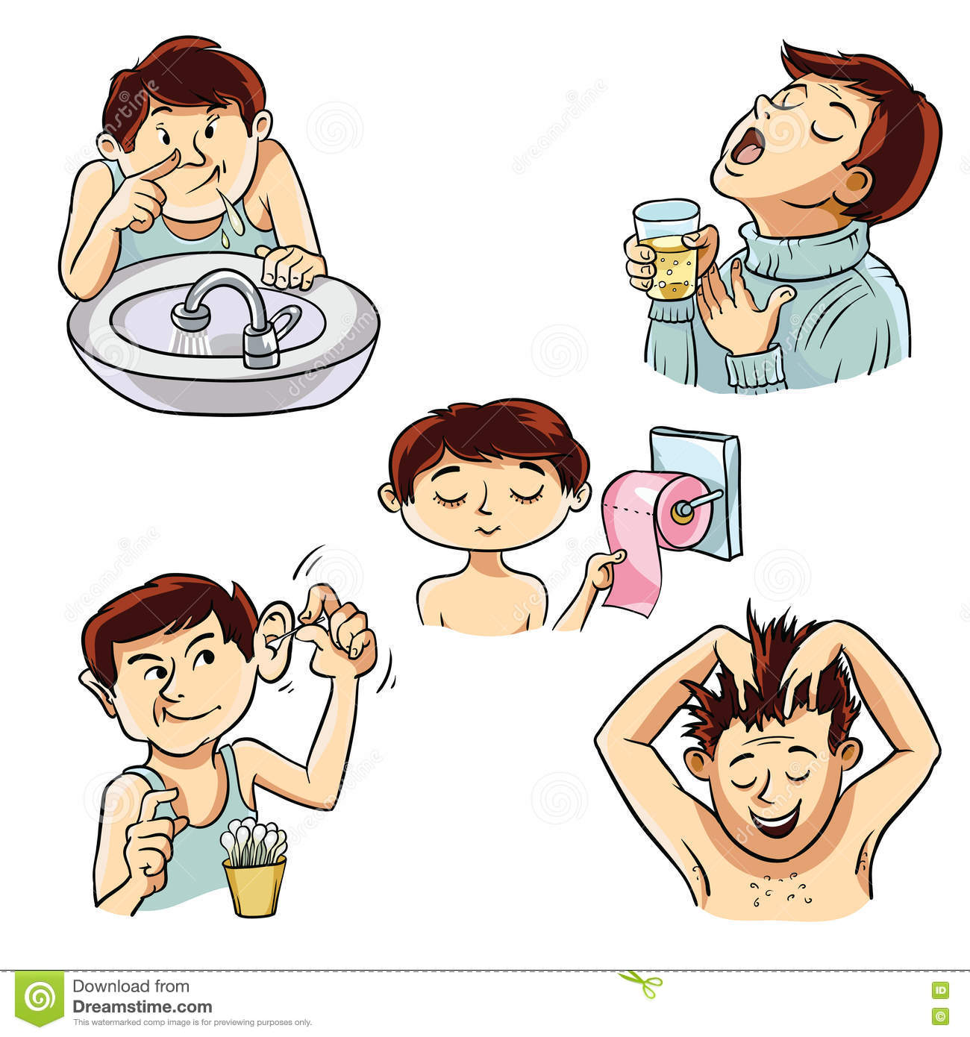
Personal Hygiene

Slide 2
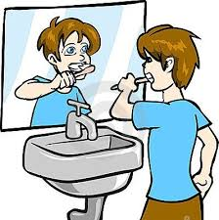
Brushing Teeth
Ideally, you should brush your teeth after every meal. At the very least, brush your teeth twice a day and floss daily. Brushing minimizes the accumulation of bacteria in your mouth, which can cause tooth decay and gum disease, Flossing, too, helps maintain strong, healthy gums.
Unhealthy gums also can cause your teeth to loosen, which makes it difficult to chew and to eat properly, he adds. To maintain a healthy smile, visit the dentist at six-month intervals for checkups and cleanings.

Slide 3
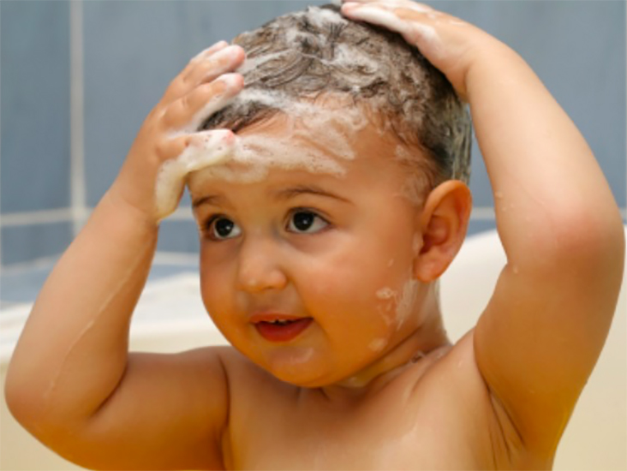
Bath Regularly
Washing and bathing are the most important ways of maintain good health and protecting ourselves from infections, illnesses and ailments.
Maintaining cleanliness is also important for our self-confidence, physical and emotional well-being. The main purpose of washing is to remove dirt and odours.
Bathing in warm water opens up pores and cleanses your skin from the inside out, leaving you soft and supple. Bathing also lifts out harmful toxins, so your skin is fresh and unbelievably clean. Bathing actually lowers blood pressure and provides an excellent respite from your busy routine.

Slide 4
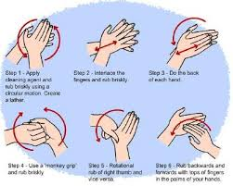
Wash hands properly
The Right way to wash your hands:-
Follow the five steps below to wash your hands the right way every time.
Wet your hands with clean, running water (warm or cold), turn off the tap, and apply soap.
Lather your hands by rubbing them together with the soap. Be sure to lather the backs of your hands, between your fingers, and under your nails.
Scrub your hands for at least 20 seconds. Need a timer? Hum the “Happy Birthday” song from beginning to end twice.
Rinse your hands well under clean, running water.
Dry your hands using a clean towel or air dry them.

Slide 5
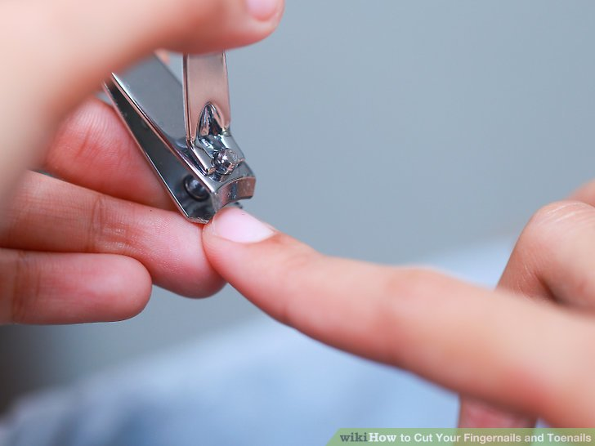
Trim your nails
6 Reasons Why You Should Trim Your Nails Regularly
It causes bacterial infection. Keeping your nails long can cause bacterial infection.
It causes fungal infection. Fungal infections are caused by fungi. ...
It causes food poisoning. ...
It causes injury. ...
It causes inward nail growth. ...
It signifies poor hygiene.

Slide 6
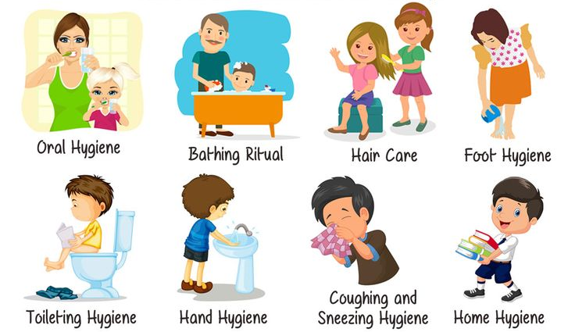

Slide 7
THANK YOU

